Slide 1
Dr.SNS RAJALAKSHMI COLLEGE OF ARTS AND SCIENCE (AUTONOMOUS) COIMBATORE-641049 Accredited by NAAC(Cycle III) with “A+” Grade Recognised by UGC, Approved by AICTE, New Delhi and Affiliated to Bharathiar University, Coimbatore.
DEPARTMENT OF COMPUTER SCIENCE
18UCS810: MOBILE APPLICATION DEVELOPMENT(Blended)
III YEAR - V SEM
UNIT 1 – INTRODUCTION TO ANDROID
TOPIC – Mobile Application Development IDE

Slide 2
Outline
Mobile UI
Mobile Application IDE
Android : Open Handset Alliance
features of Android
Android Application
Categories of Android Application
History of Android

Slide 3
Mobile UI
A mobile user interface (mobile UI) is the graphical and usually touch-sensitive display on a mobile device, such as a smartphone or tablet, that allows the user to interact with the device’s apps, features, content and functions.

Slide 4
Mobile UI Importance
Constraints
Contexts
Screen
Input
Mobility

Slide 5
Mobile Application IDE
The UI of mobile apps should: consider users' limited attention, minimize keystrokes, and be task-oriented with a minimum set of functions. This functionality is supported by integrated development environments (IDEs).
One of the best mobile application IDE is Android studio

Slide 6
Android
Android is a complete set of software for mobile devices such as tablet computers, notebooks, smartphones, etc..,
Android : Linux based OS
It is developed by Google and later the OHA (Open Handset Alliance).
Java language is mainly used to write the android code even though other languages can be used.

Slide 7
OHA:Open Handset Alliance
OHA is a consortium of 84 companies such as google, samsung, Ebay, Intel etc.
OHA was established on 5th November, 2007, led by Google. It is committed to advance open standards, provide services and deploy handsets using the Android Platform.

Slide 8
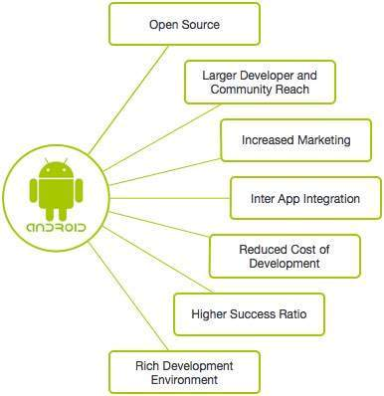
Features of Android

Slide 9
Android Application
Android applications are usually developed in the Java language using the Android SDK
Once developed, Android applications can be packaged easily and sold out either through a store such as Google Play, SlideME, Opera Mobile Store, and the Amazon Appstore.

Slide 10
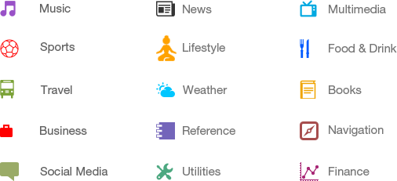
Categories of Android

Slide 11
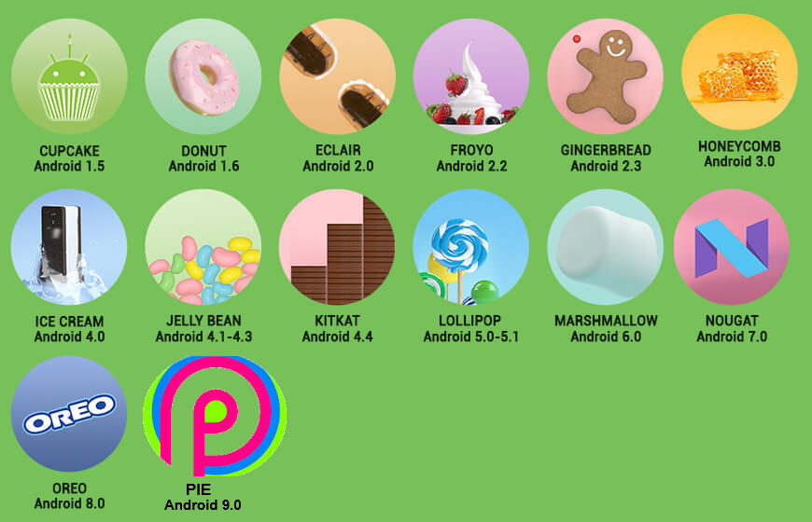
History of Android

